Slide 1
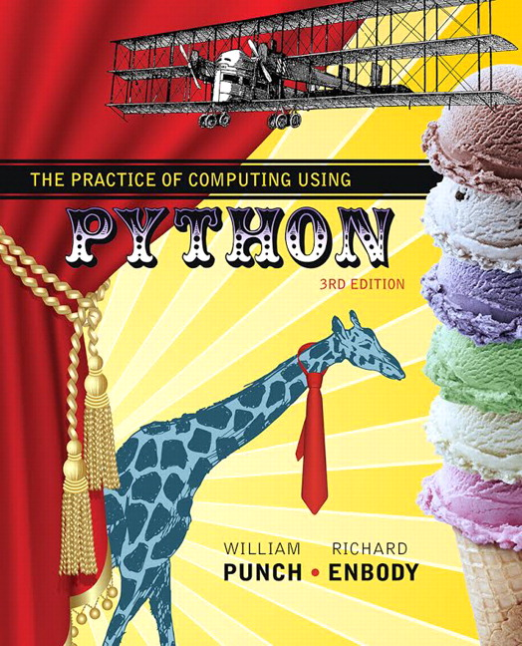
The Practice of Computing Using Python
Third Edition
Chapter 8
More On Functions
Copyright © 2017, 2013, 2011 Pearson Education, Inc. All Rights Reserved
Notes:
If this PowerPoint presentation contains mathematical equations, you may need to check that your computer has the following installed:
1) MathType Plugin
2) Math Player (free versions available)
3) NVDA Reader (free versions available)

Slide 2
First cut, scope

Slide 3
Defining scope
“The set of program statements over which a variable exists, i.e., can be referred to”
it is about understanding, for any variable, what its associated value is.
the problem is that multiple namespaces might be involved

Slide 4
Find the namespace
For Python, there are potentially multiple namespaces that could be used to determine the object associated with a variable.
Remember, namespace is an association of name and objects
We will begin by looking at functions.

Slide 5
A Function’s Namespace
Each function maintains a namespace for names defined locally within the function.
Locally means one of two things:
a name assigned within the function
an argument received by invocation of the function

Slide 6
Passing Argument to Parameter
For each argument in the function invocation, the argument’s associated object is passed to the corresponding parameter in the function

Slide 7
Passing immutable objects

Slide 8
Figure 8.1 Function namespace: at Function Start

Slide 9
What Does “pass” Mean?
The diagram should make it clear that the parameter name is local to the function namespace
Passing means that the argument and the parameter, named in two different namespaces, share an association with the same object
So “passing” means “sharing” in Python

Slide 10
Assignment changes association
if a parameter is assigned to a new value, then just like any other assignment, a new association is created
This assignment does not affect the object associated with the argument, as a new association was made with the parameter

Slide 11
Figure 8.2 Function Namespace Modified

Slide 12
Passing Mutable Objects

Slide 13
Sharing Mutables
When passing mutable data structures, it is possible that if the shared object is directly modified, both the parameter and the argument reflect that change
Note that the operation must be a mutable change, a change of the object. An assignment is not such a change.

Slide 14
Figure 8.3 Function Namespace With Mutable Objects: at Function Start

Slide 15
Figure 8.3 Function Namespace With Mutable Objects after param_list[0]=100

Slide 16
More on Functions

Slide 17
Functions Return One Thing
Functions return one thing, but it can be a ‘chunky’ thing. For example, it can return a tuple

Slide 18
Assignment in a Function
if you assign a value in a function, that name becomes part of the local namespace of the function
it can have some odd effects
Notes:
Note back to other example we talked about, where function can access value in main unless it also assigns something to that value, show that get error, ask why (write out namespaces in idle)
def my_fun():
print a
a=20
print a
a=10
my_fun()

Slide 19
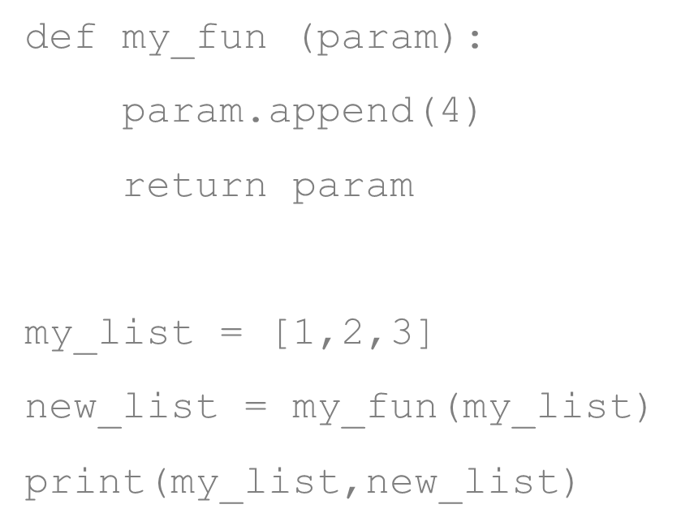
Example 1 (1 of 3)

Slide 20
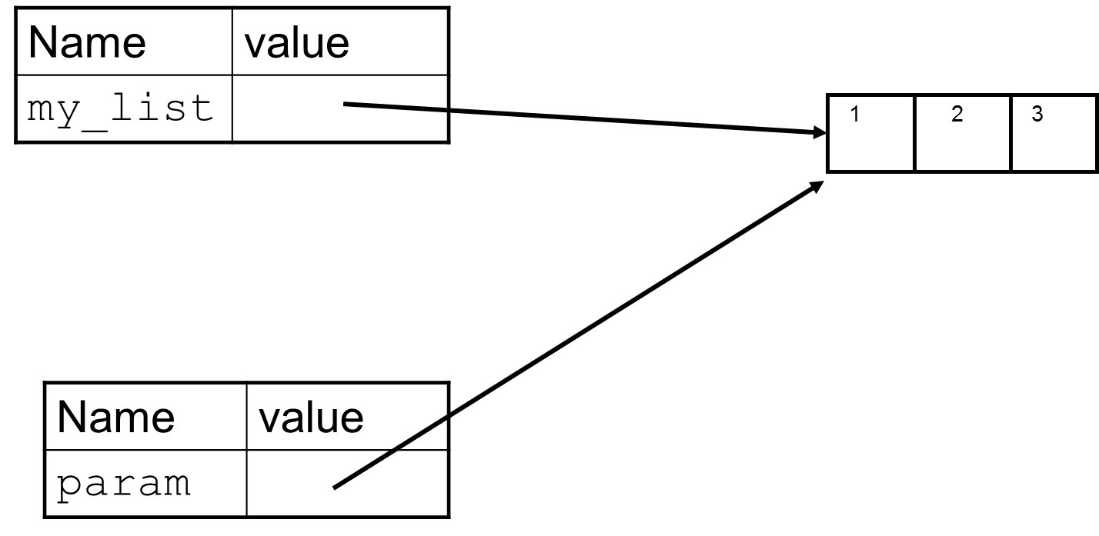
Example 1 (2 of 3)
Main Namespace
my_fun Namespace
Notes:
Go back and forth between idle and this, print “param is my_list” on 1st line of function

Slide 21
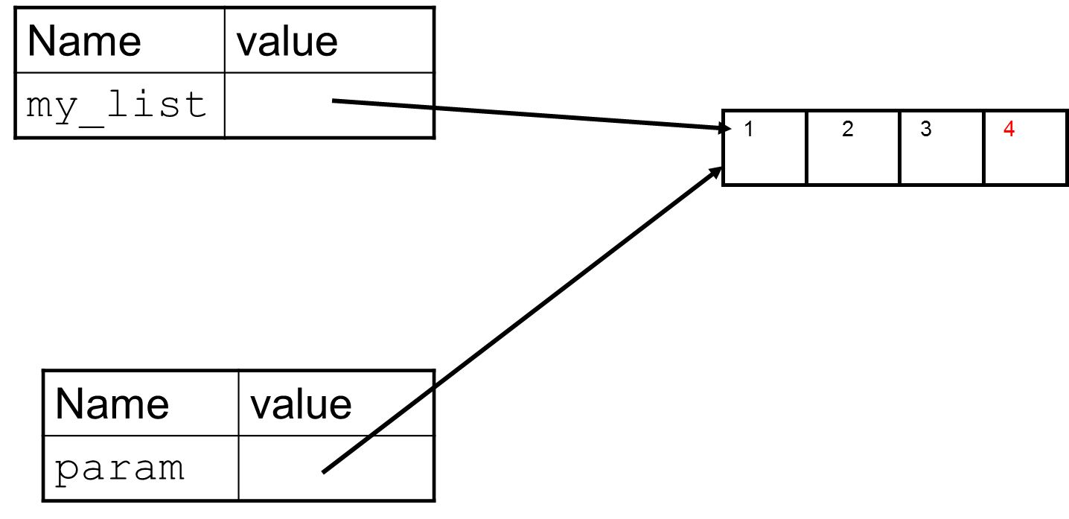
Example 1 (3 of 3)
Main Namespace
my_fun Namespace
Notes:
Go back and forth between idle and this, print “param is my_list” on 1st line of function

Slide 22
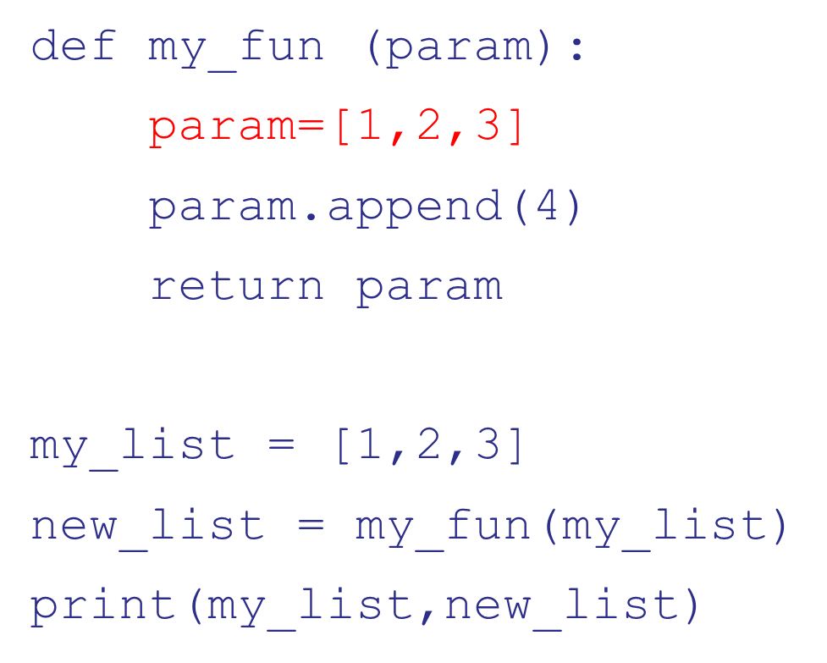
Example 2 (1 of 4)
Notes:
Show in idle with, ask them what should get each time

Slide 23
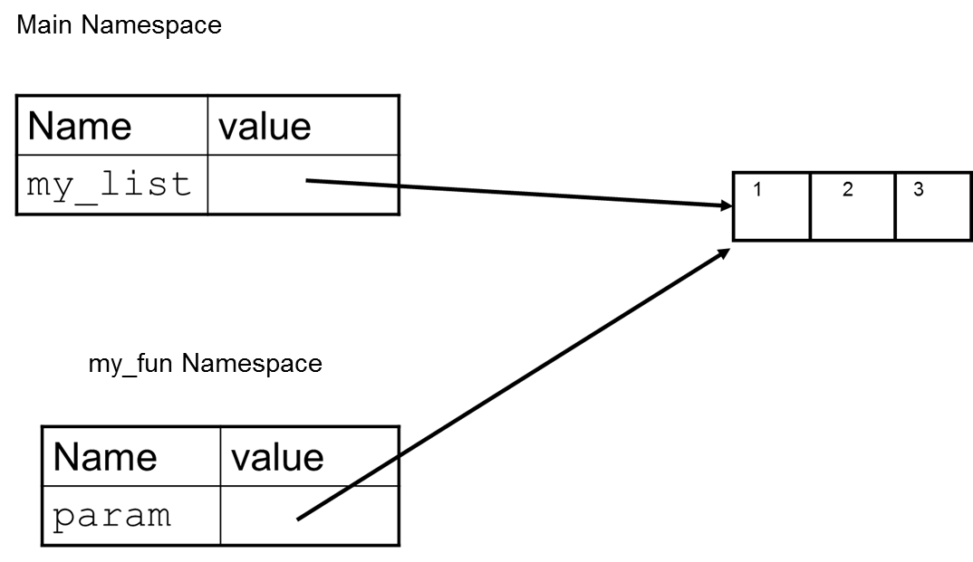
Example 2 (2 of 4)
Notes:
Go back and forth between idle and this, print “param is my_list” on 1st line of function

Slide 24
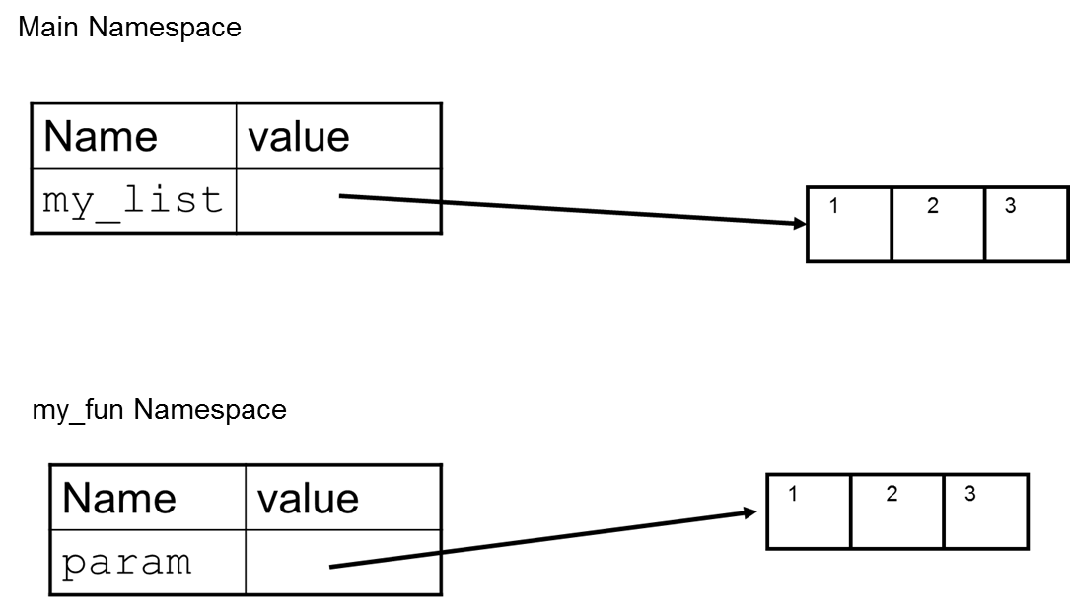
Example 2 (3 of 4)
Notes:
Go back and forth between idle and this, print “param is my_list” on 1st line of function

Slide 25
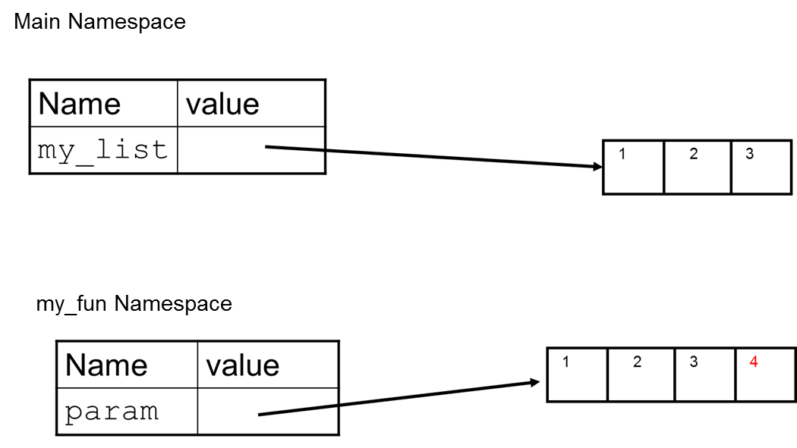
Example 2 (4 of 4)
Notes:
Go back and forth between idle and this, print “param is my_list” on 1st line of function

Slide 26
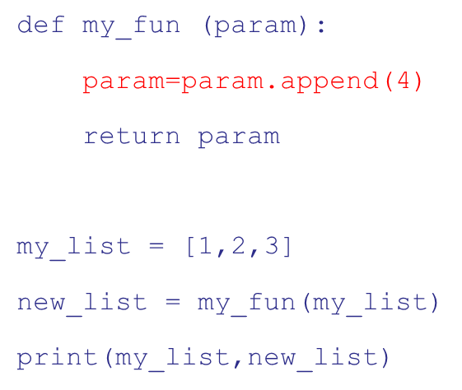
Example 3 (1 of 4)
Notes:
Show in idle with, ask them what should get each time

Slide 27
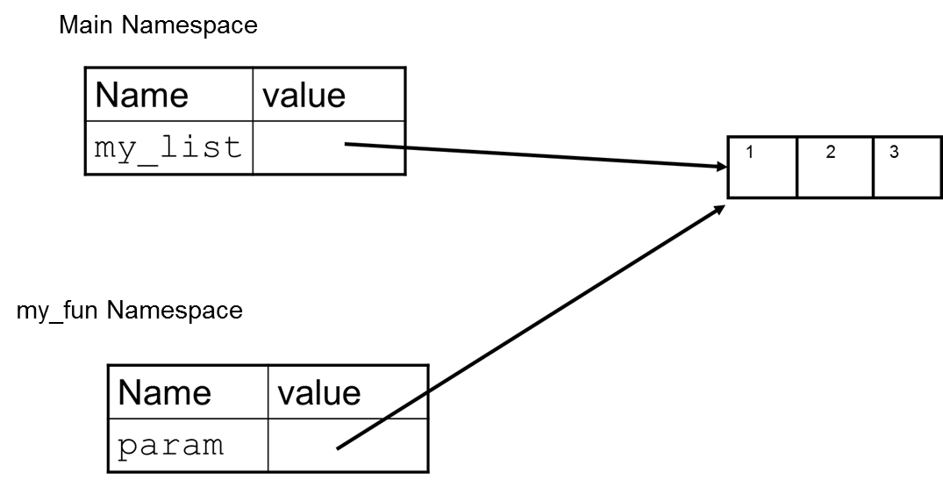
Example 3 (2 of 4)
Notes:
Go back and forth between idle and this, print “param is my_list” on 1st line of function

Slide 28
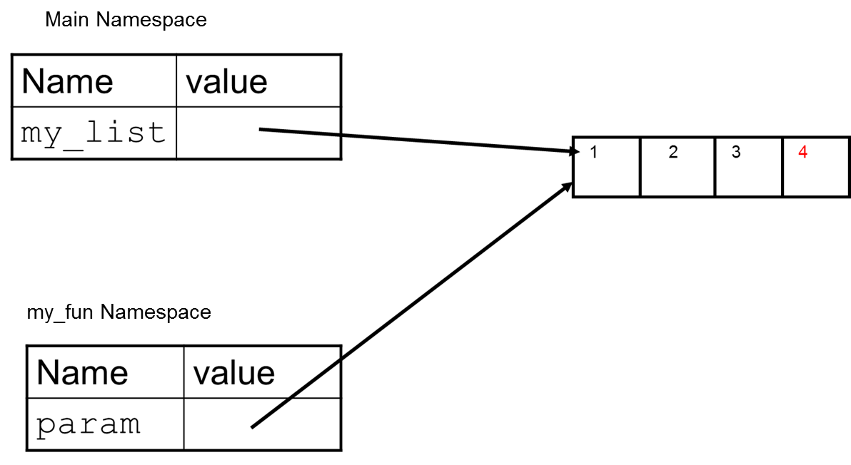
Example 3 (3 of 4)
Notes:
Go back and forth between idle and this, print “param is my_list” on 1st line of function

Slide 29

Example 3 (4 of 4)
Notes:
Go back and forth between idle and this, print “param is my_list” on 1st line of function

Slide 30
Assignment to a Local
assignment creates a local variable
changes to a local variable affects only the local context, even if it is a parameter and mutable
If a variable is assigned locally, cannot reference it before this assignment, even if it exists in main as well

Slide 31
Default and Named Parameters
The parameter assignment means two things:
if the caller does not provide a value, the default is the parameter assigned value
you can get around the order of parameters by using the name

Slide 32
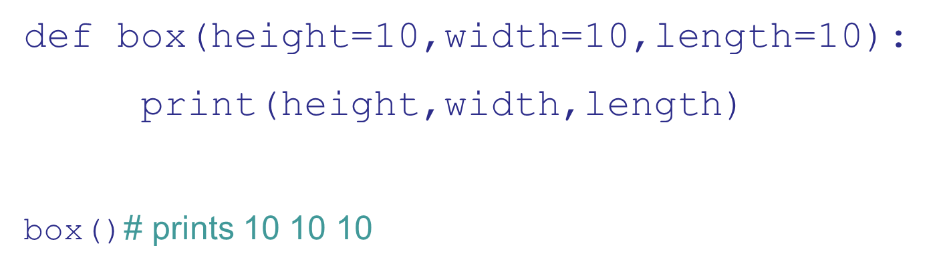
Defaults

Slide 33
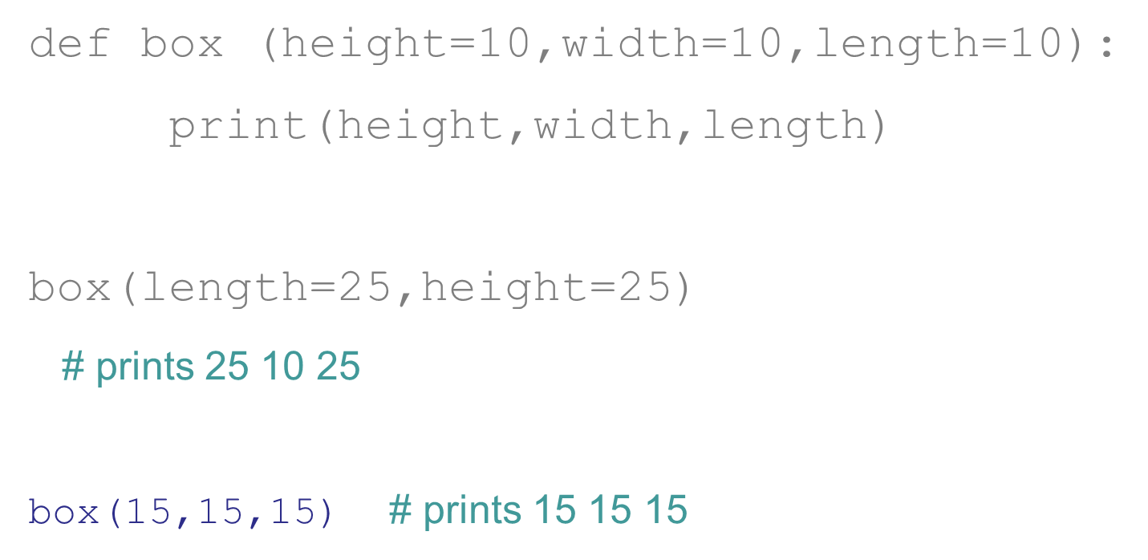
Named Parameter

Slide 34
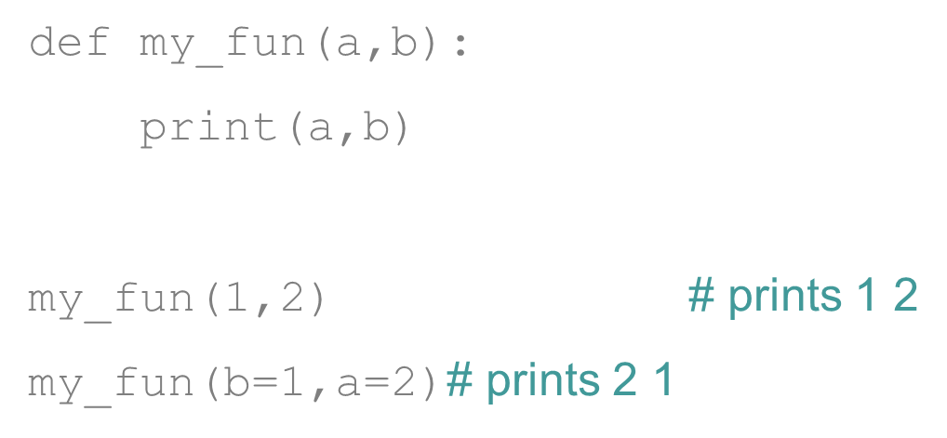
Name Use Works in General Case
Notes:
Show in idle

Slide 35
Default Args and Mutables (1 of 3)
One of the problem with default args occurs with mutables. This is because:
the default value is created once, when the function is defined, and stored in the function name space
a mutable can change that value of that default

Slide 36
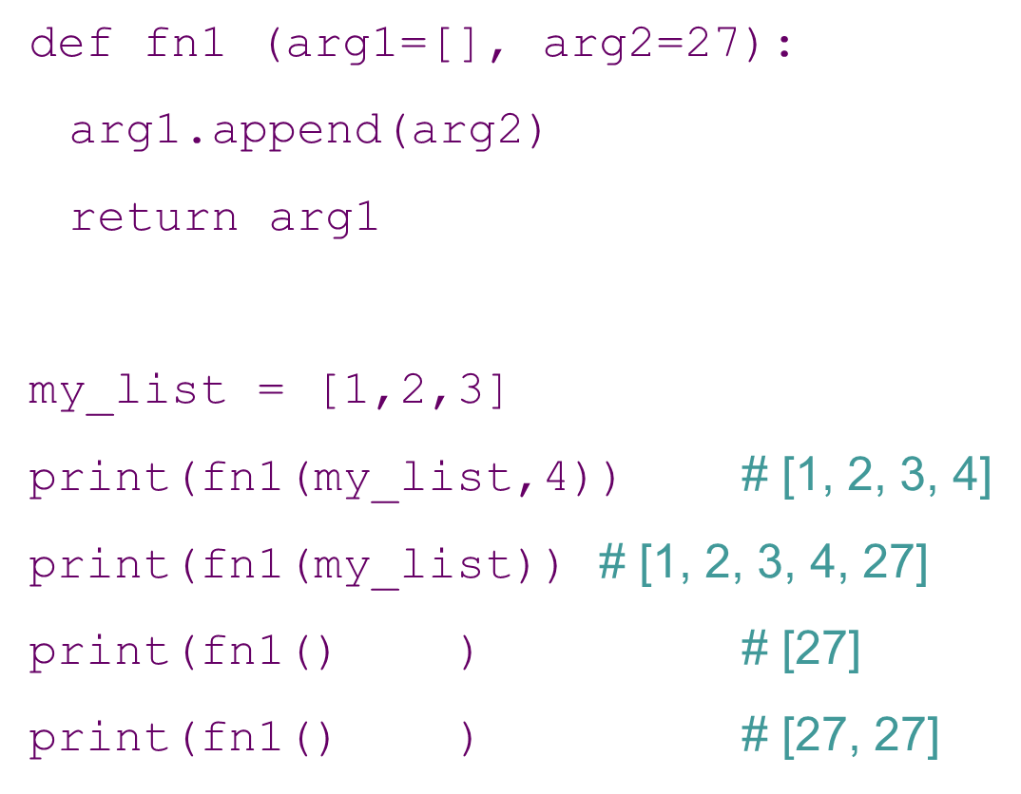
Weird

Slide 37
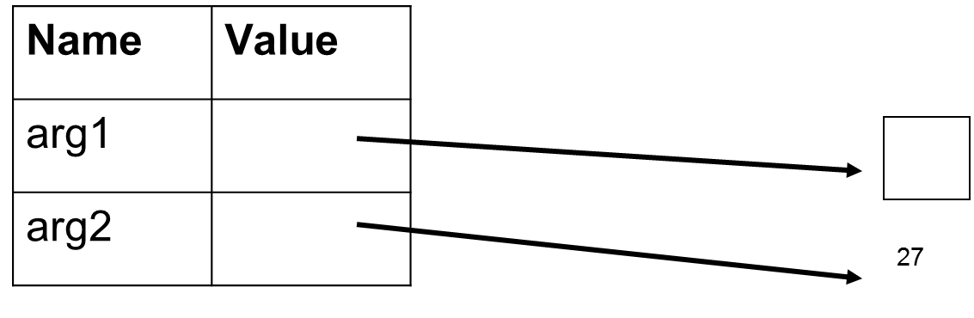
Default Args and Mutables (2 of 3)
arg1 is either assigned to the passed arg or to the function default for the arg
fn1 Namespace
Notes:
Go back and forth between idle and this, print “param is my_list” on 1st line of function

Slide 38
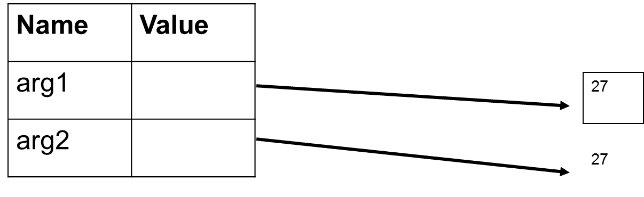
Default Args and Mutables (3 of 3)
Now the function default, a mutable, is updated and will remain so for the next call
fn1 Namespace
Notes:
Go back and forth between idle and this, print “param is my_list” on 1st line of function

Slide 39
Functions as objects and docstrings

Slide 40
Functions are Objects too!
Functions are objects, just like anything else in Python.
As such, they have attributes:
__name__ : function name
__str__ : string function
__dict__ : function namespace
__doc__ : docstring

Slide 41
Function Annotations
You can associate strings of information, ignored by Python, with a parameter
to be used by the reader or user the colon “:” indicates the parameter annotation
the “->” the annotation is associated with the return value
stored in dictionary name_fn.__annotations__

Slide 42
Example: Function Annotations

Slide 43
Docstring
If the first item after the def is a string, then that string is specially stored as the docstring of the function
This string describes the function and is what is shown if you do a help on a function
Usually triple quoted since it is multilined

Slide 44
Can ask for docstring
Every object (function, whatever) can have a docstring. It is stored as an attribute of the function (the __doc__ attribute)
listMean.__doc__
‘Takes a list of integers, returns the average of the list.’
Other programs can use the docstring to report to the user (for example, Spyder).
Notes:
Show example of str.__doc__ and int.__doc__

Slide 45
Determining final grade
The following code shows how you can read in a file of grades. Each line of the file contains five comma-separated fields:
last name
first name
exam1, exam2, final_exam
print name and final grade

Slide 46
Code Listing 8.2 Weighted Grade Function

Slide 47
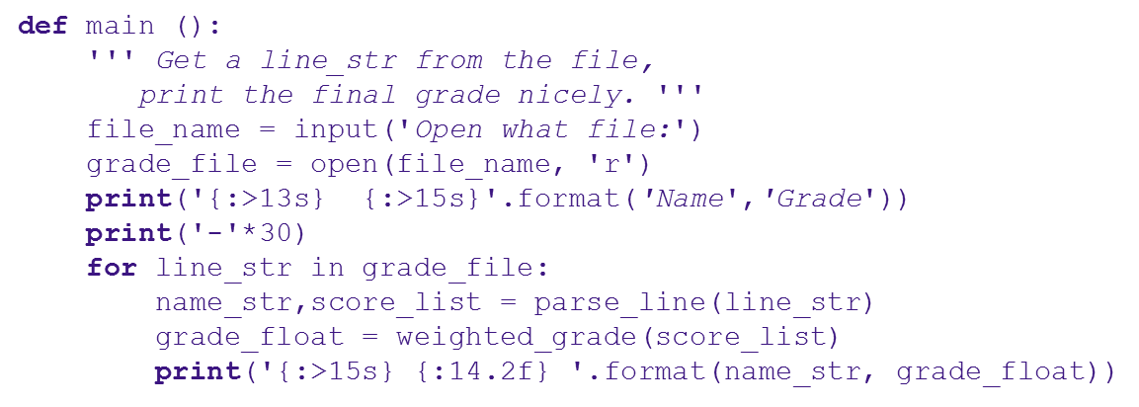
Code Listing 8.3 parse_line

Slide 48
Arbitrary arguments
it is also possible to pass an arbitrary number of arguments to a function
the function simply collects all the arguments (no matter how few or many) into a tuple to be processed by the function
tuple parameter preceeded by a * (which is not part of the param name, its part of the language)
positional arguments only

Slide 49
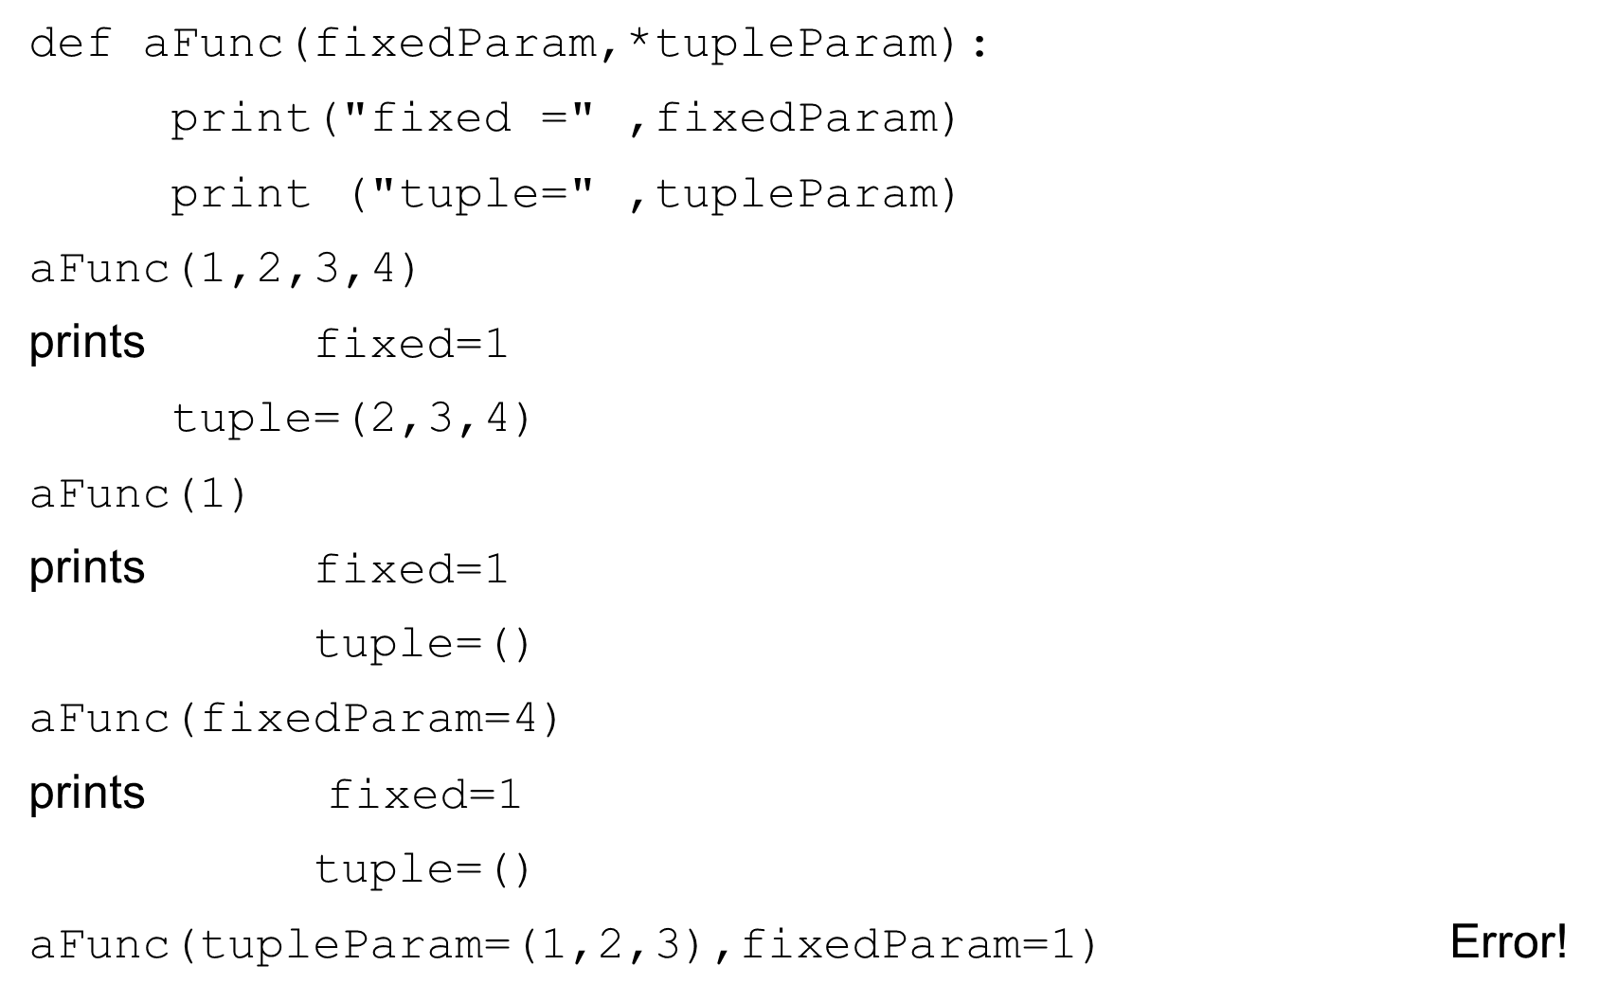
Example 4: Arbitrary arguments

Slide 50
Reminder, rules so far
Think before you program!
A program is a human-readable essay on problem solving that also happens to execute on a computer.
The best way to imporve your programming and problem solving skills is to practice!
A foolish consistency is the hobgoblin of little minds
Test your code, often and thoroughly
If it was hard to write, it is probably hard to read. Add a comment.
All input is evil, unless proven otherwise.
A function should do one thing.

Slide 51
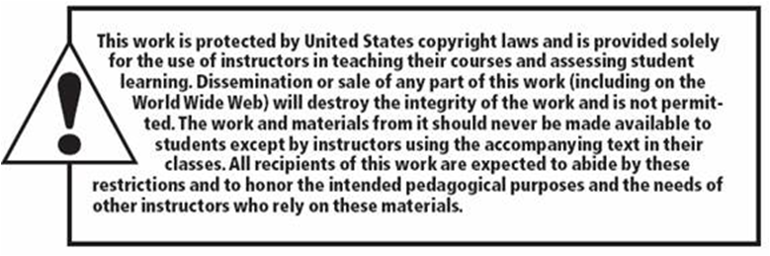
Copyright

